Slide 1
Breast Cancer Detection

Slide 2
Data Description :-
In this research, the experiments were performed on datasets: WDBC
Wisconsin Diagnostic Breast Cancer (WDBC): The WDBC dataset consists of 10 features of breast tumor, and the result in the data were taken from 569 patients.

Slide 3
Novel Framework :-

Slide 4
Data Exploratory Techniques (DET) :-
Feature Distribution: First, the distribution of each feature was observed to find how these features are different from each other, i.e., benign and malignant in the WDBC dataset and the presence and absence of breast cancer in the BCCD dataset.
Feature Correlation: Next, the Pearson Correlation Coefficient (r) calculates the correlation coefficient between each of the two features.
Recursive features elimination (RFE): RFE is one of the essential processes of machine learning. Since the dataset has many features, selecting the number of features that give the most optimal prediction result is important for improving model performance.
Hyperparameter Optimization: Hyperparameters optimization is a process of machine learning used for tuning a set of optimal parameters.

Slide 5
Predictive Models In this study, four ML classifiers were utilized as predictive models (PM) to diagnose :-
PM1—SVM: The first model applied SVM as a predictive model. SVM is one of the robust supervised machine learning algorithms used to solve classification and regression tasks.
PM2—LR: Our second model applied LR to predict the outcomes. LR is one of the most widespread machine learning techniques. It is mainly used to predict a binary variable with a large number of independent variables. It is efficient to forecast the probability of being 0 or 1 based on predictors .
PM3—KNN: The third model applied KNN as a predictive model. The KNN algorithm used in our problem considered the output a target class. The problem was solved or classified by the majority vote of its neighbors, where the value of K was taken as a small and real-valued positive integer.
PM4—EC: The fourth model applies the ensemble classifier method as a predictive model. It aims to maximize the precision and recall value to detect all malignant tumors in the WDBC dataset and detect all cancer presence in the BCCD dataset. Our research applied an ensemble classifier to optimize the logistic regression model.

Slide 6
PM1—SVM : -

Slide 7
PM2—LR :-

Slide 8
PM3—KNN :-

Slide 9
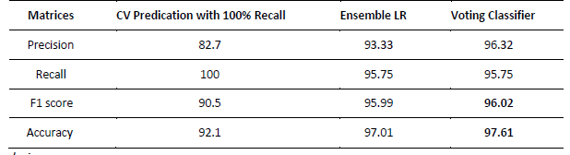
PM4—EC :-
Performance comparison of Ensemble LR, voting classifier (CV), and voting classifier prediction with 100% recall.

Slide 10
Comparison of all prediction models and methods under the cross-validation matrices :-

Slide 11
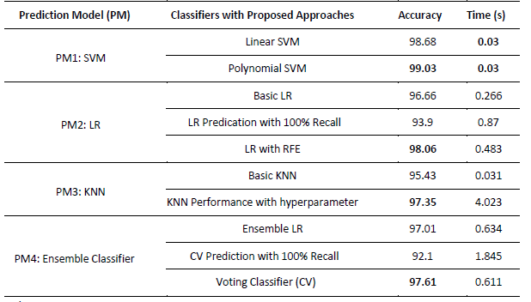
Execution time comparison of each model along with best-achieved accuracy :-

Slide 12
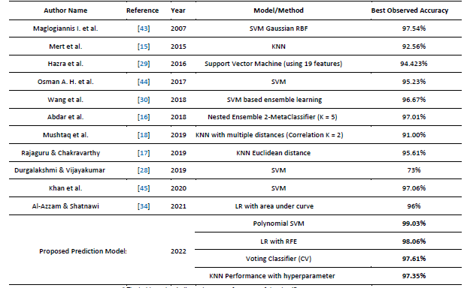
Accuracy comparison of our proposed breast cancer prediction models with previous studies that used the same WDBC dataset :-

Slide 13
THANKS

